Slide 1
Binary Search Tree(BST)

Slide 2
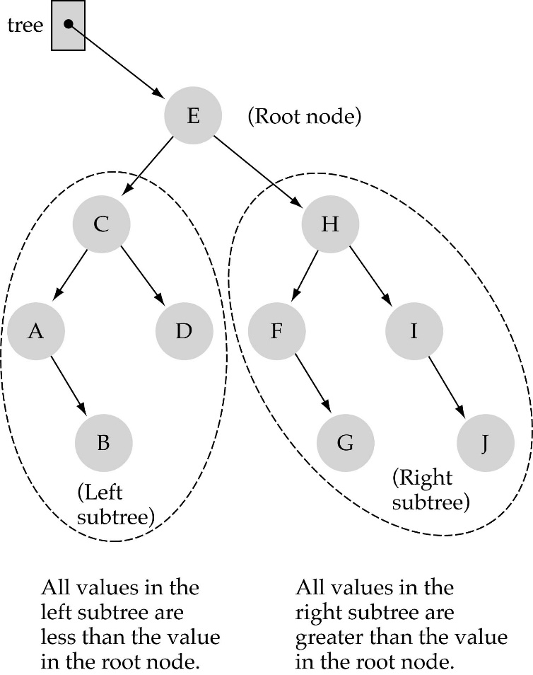
Binary Search Trees (BSTs)
Binary Search Tree Property:
The value stored at
a node is greater than
the value stored at its
left child and less than
the value stored at its
right child

Slide 3

Binary Search Trees (BSTs)
In a BST, the value stored at the root of a subtree is greater than any value in its left subtree and less than any value in its right subtree!

Slide 4
Binary Search Trees (BSTs)
Where is the smallest element?
Ans: leftmost element
Where is the largest element?
Ans: rightmost element

Slide 5

How to search a binary search tree?
(1) Start at the root
(2) Compare the value of the item you are searching for with the value stored at the root
(3) If the values are equal, then item found; otherwise, if it is a leaf node, then not found

Slide 6
How to search a binary search tree?
(4) If it is less than the value stored at the root, then search the left subtree
(5) If it is greater than the value stored at the root, then search the right subtree
(6) Repeat steps 2-6 for the root of the subtree chosen in the previous step 4 or 5

Slide 7
How to search a binary search tree?
Is this better than searching
a linked list?
Yes !! ---> O(logN)

Slide 8
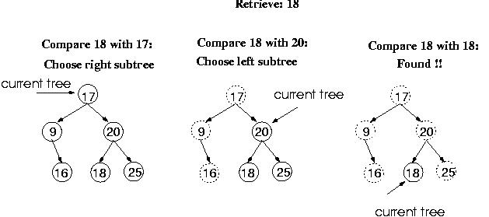
Function RetrieveItem

Slide 9
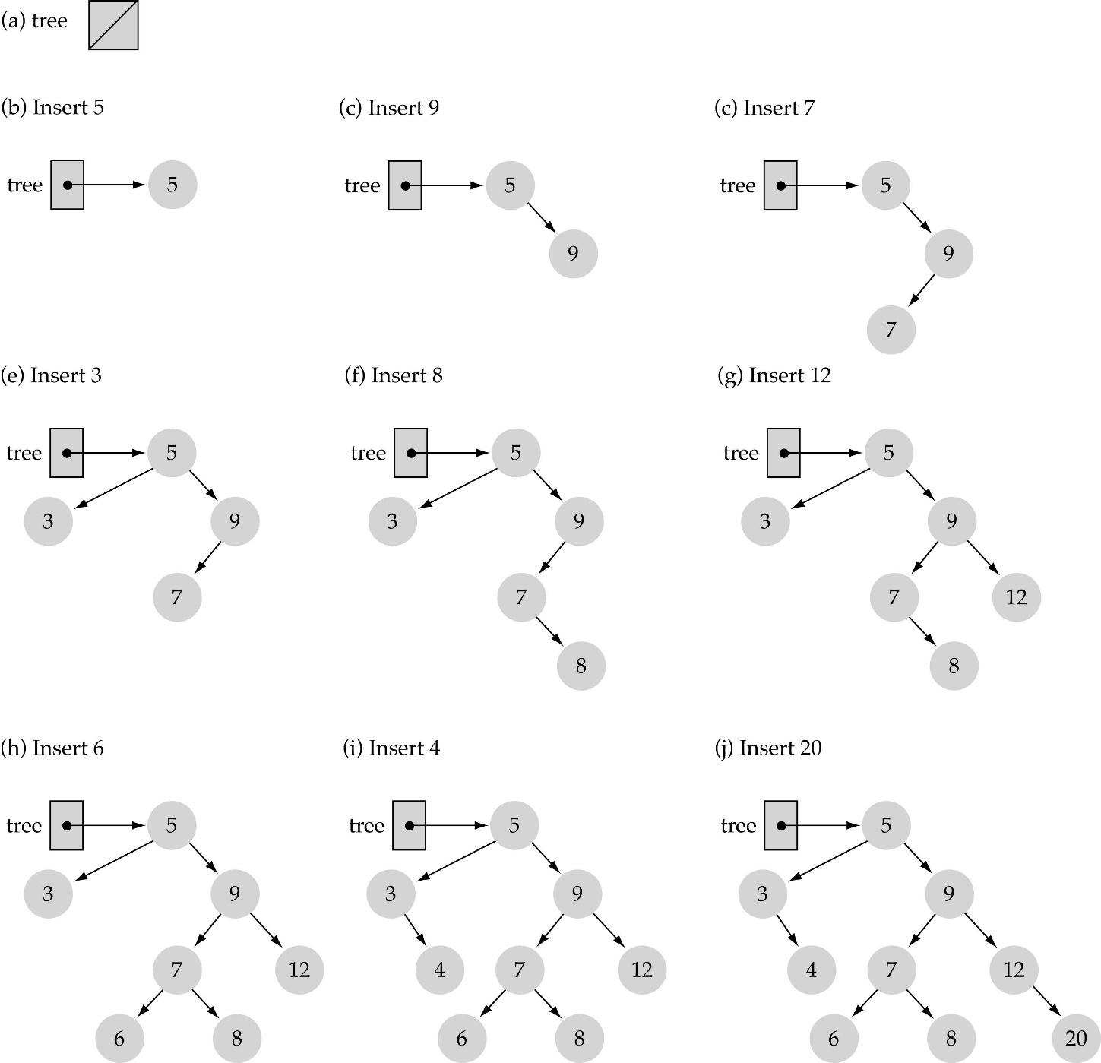
Function InsertItem
Use the binary search tree property to insert the new item at the correct place

Slide 10
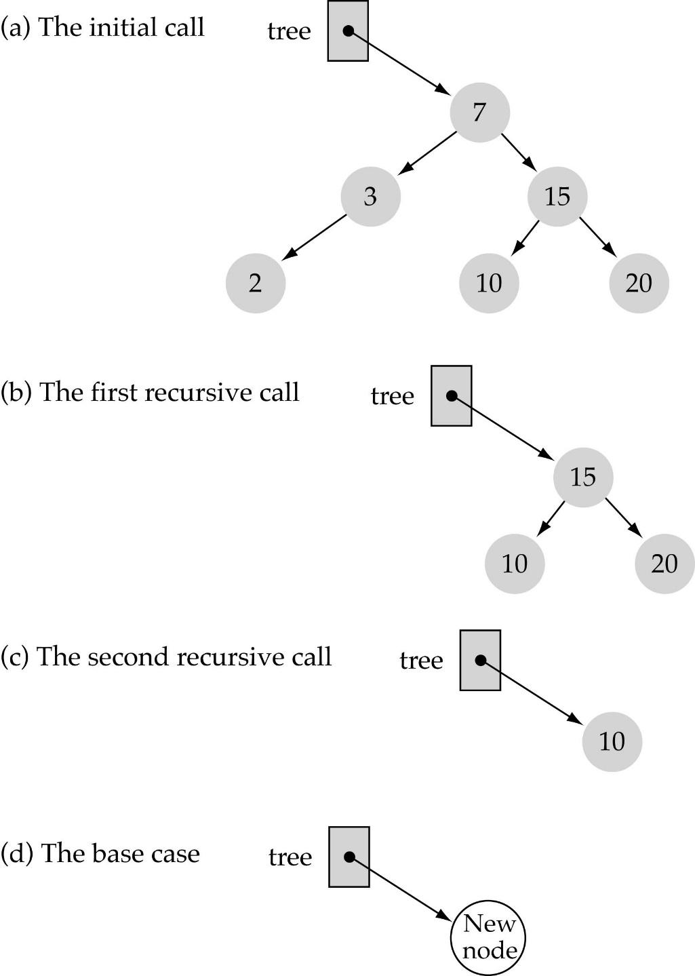
Function InsertItem
(cont.)
Implementing insertion resursively
e.g., insert 11

Slide 11

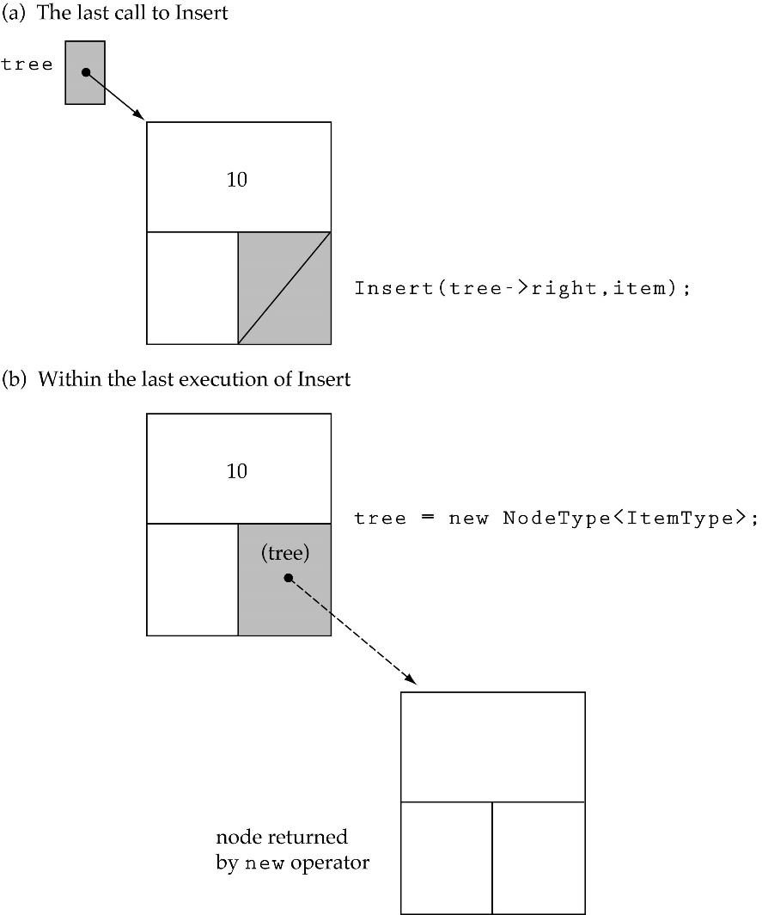
Function InsertItem (cont.)
Insert 11

Slide 12
Does the order of inserting elements into a tree matter?
Yes, certain orders might produce very unbalanced trees!

Slide 13
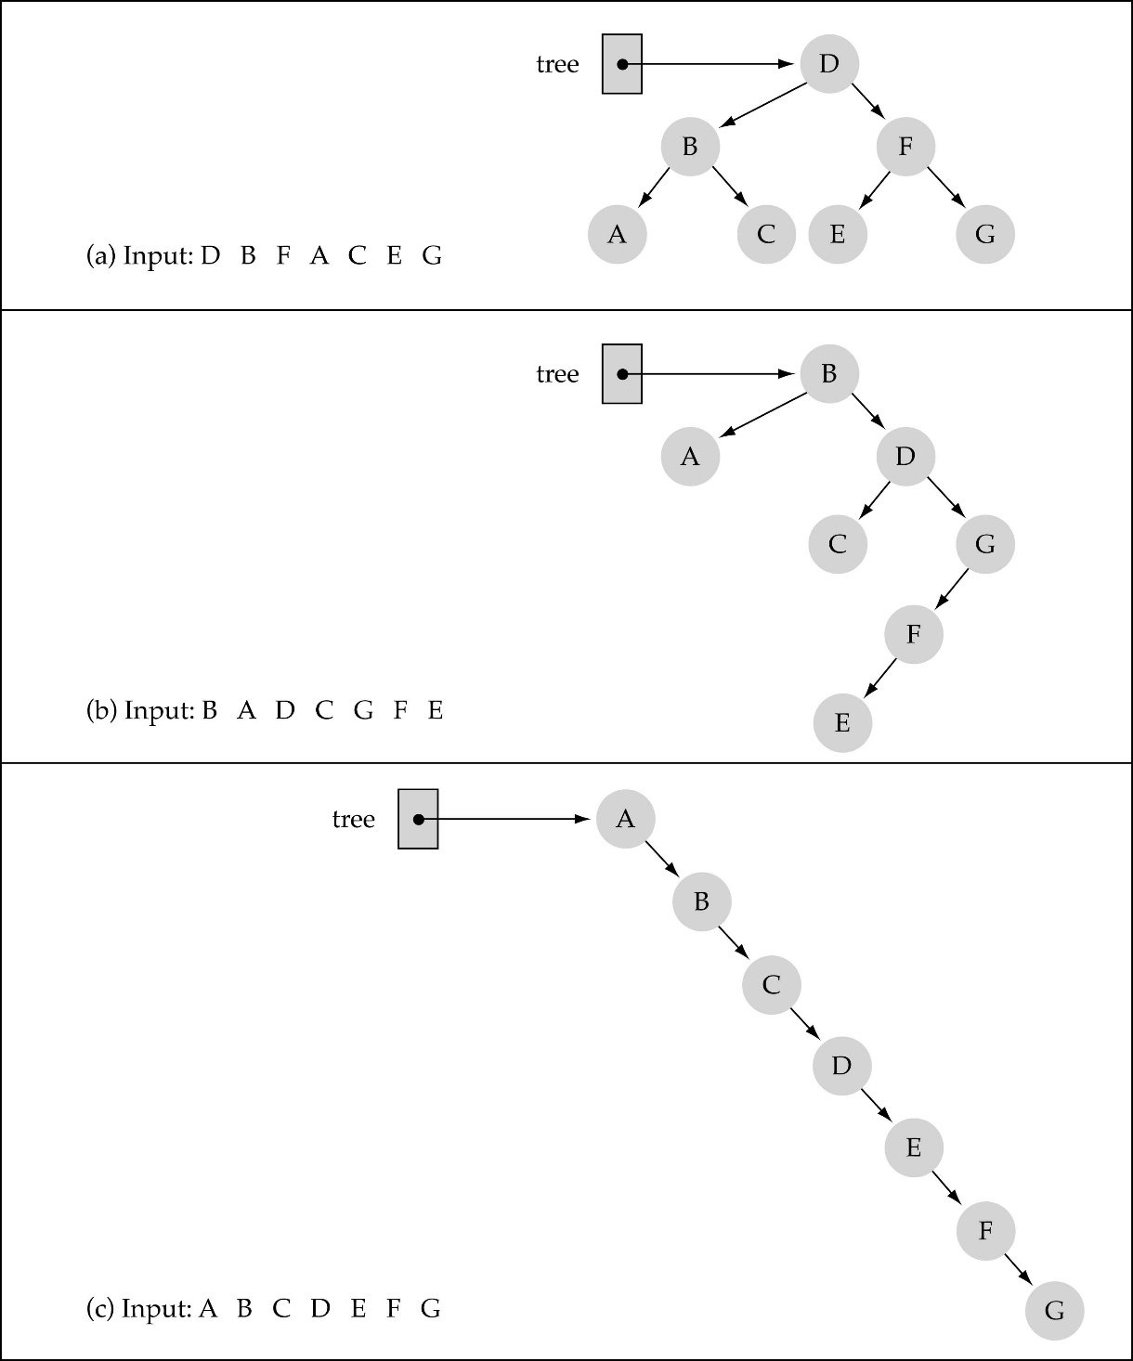
Does the order of inserting elements into a tree matter?
(cont.)

Slide 14
Does the order of inserting elements into a tree matter? (cont’d)
Unbalanced trees are not desirable because search time increases!
Advanced tree structures, such as red-black trees, guarantee balanced trees.

Slide 15
Function DeleteItem
First, find the item; then, delete it
Binary search tree property must be preserved!!
We need to consider three different cases:
(1) Deleting a leaf
(2) Deleting a node with only one child
(3) Deleting a node with two children

Slide 16
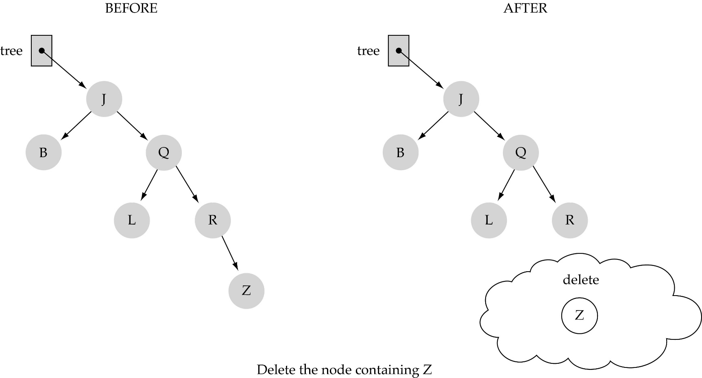
(1) Deleting a leaf

Slide 17
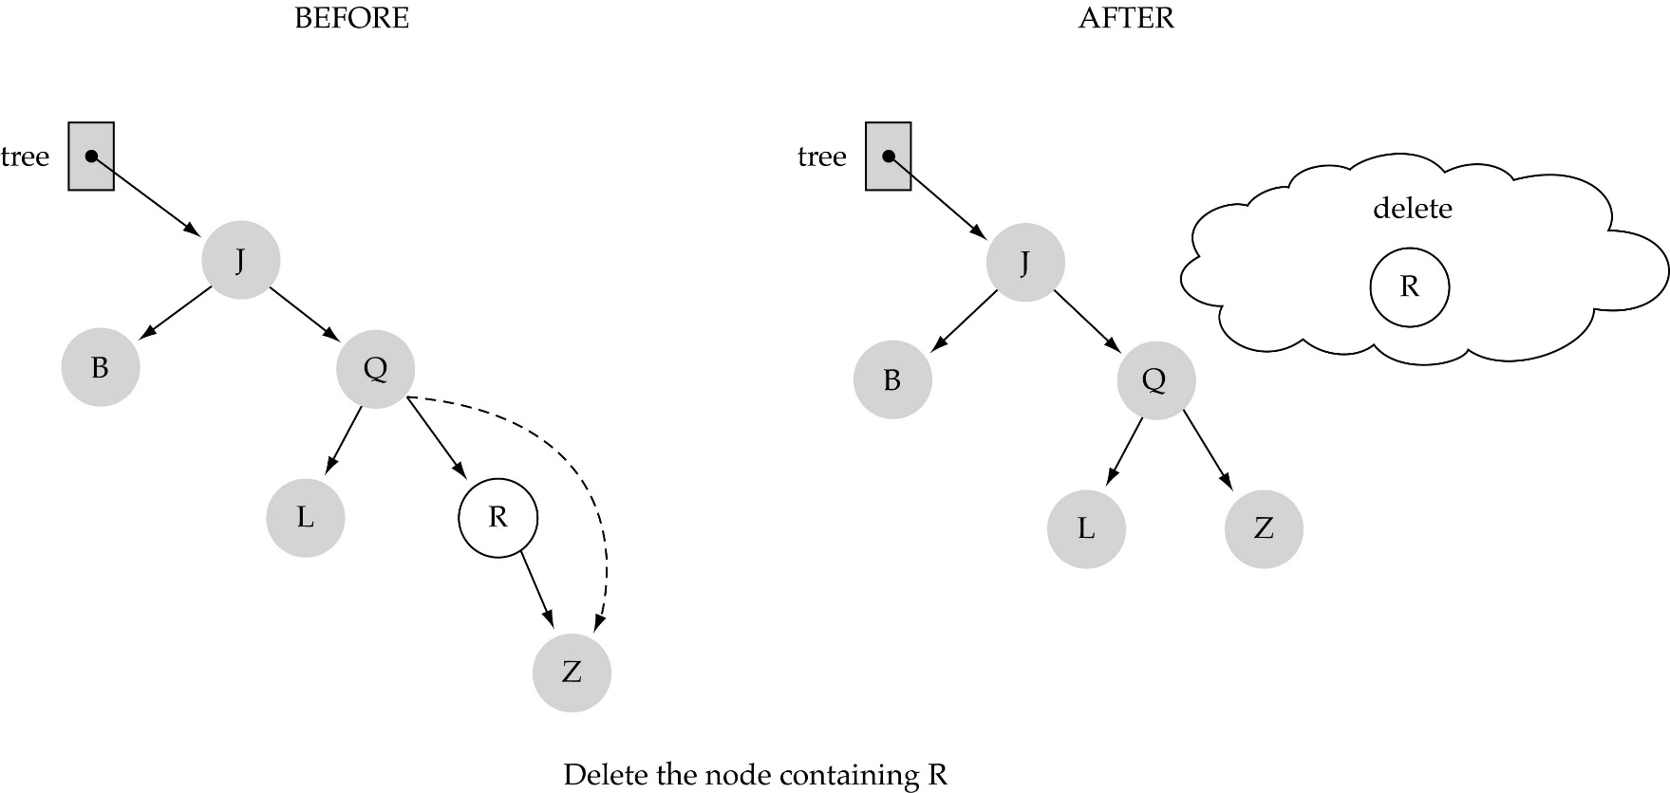
(2) Deleting a node with only one child

Slide 18
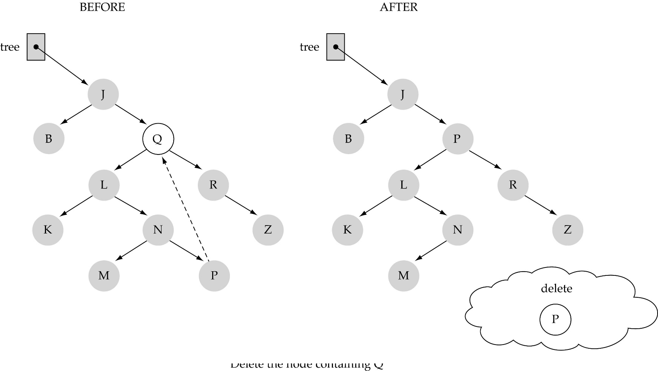
(3) Deleting a node with two children

Slide 19
(3) Deleting a node with two children (cont.)
Find predecessor (i.e., rightmost node in the left subtree)
Replace the data of the node to be deleted with predecessor's data
Delete predecessor node

Slide 20
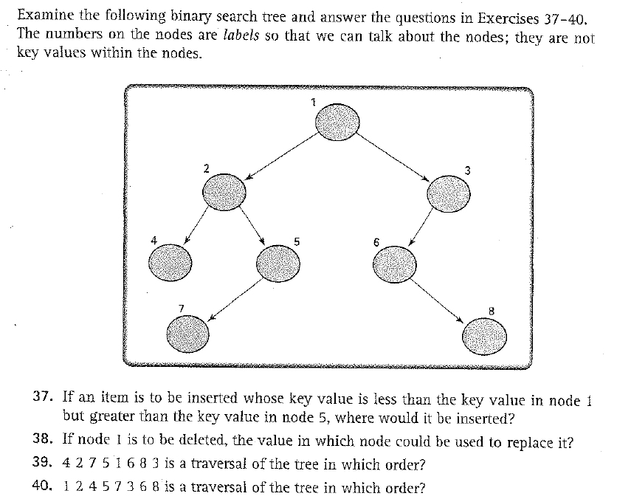
Exercises 37-41 (p. 539)

Slide 21
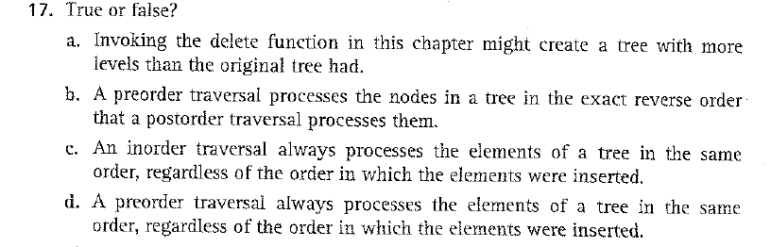
Exercise 17 (p. 537)

Slide 22

Exercise 18 (p. 537)

